Slide 1

Combining Human and Machine Transcriptions on the Zooniverse Platform
Danny Hanson

Slide 2
Overview
Background
What is transcription?
Transcription approaches
Handwriting recognition model
Results
Next steps
Questions
Interactive session w/ Keras

Slide 3
Background

Slide 4
About Me
Formerly:
Carleton College: Computer Science
Chicago Botanic Garden: Research Intern
University of Minnesota: Data Science
Currently:
Target: Supply Chain Business Analyst

Slide 5
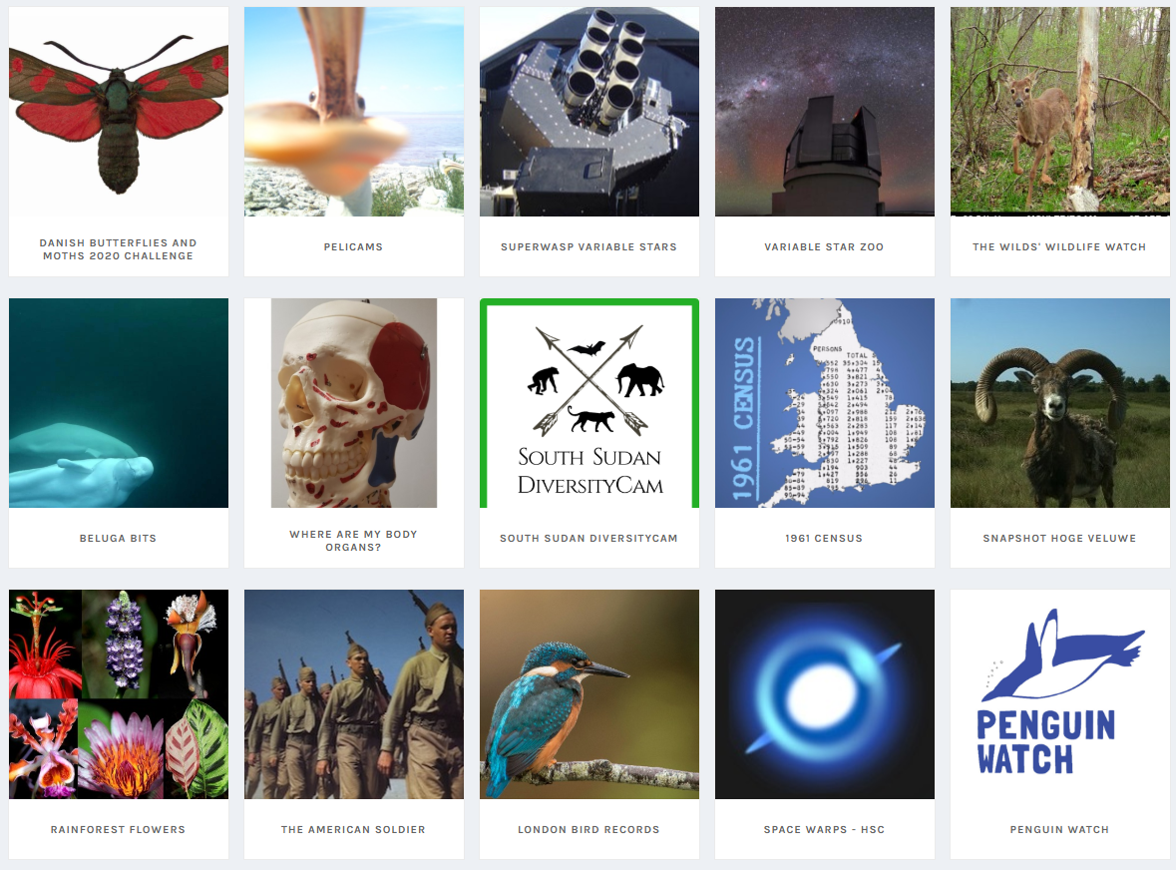
About Zooniverse
Crowdsourcing platform for researchers
Projects in many subject areas
Astronomy
Biology
History
Disaster relief
Currently working on a spinoff company
1715 Labs
UI on top of Amazon Mechanical Turk

Slide 6
What is transcription?

Slide 7
What is transcription?
The process of converting physical documents into machine readable text.

Slide 8
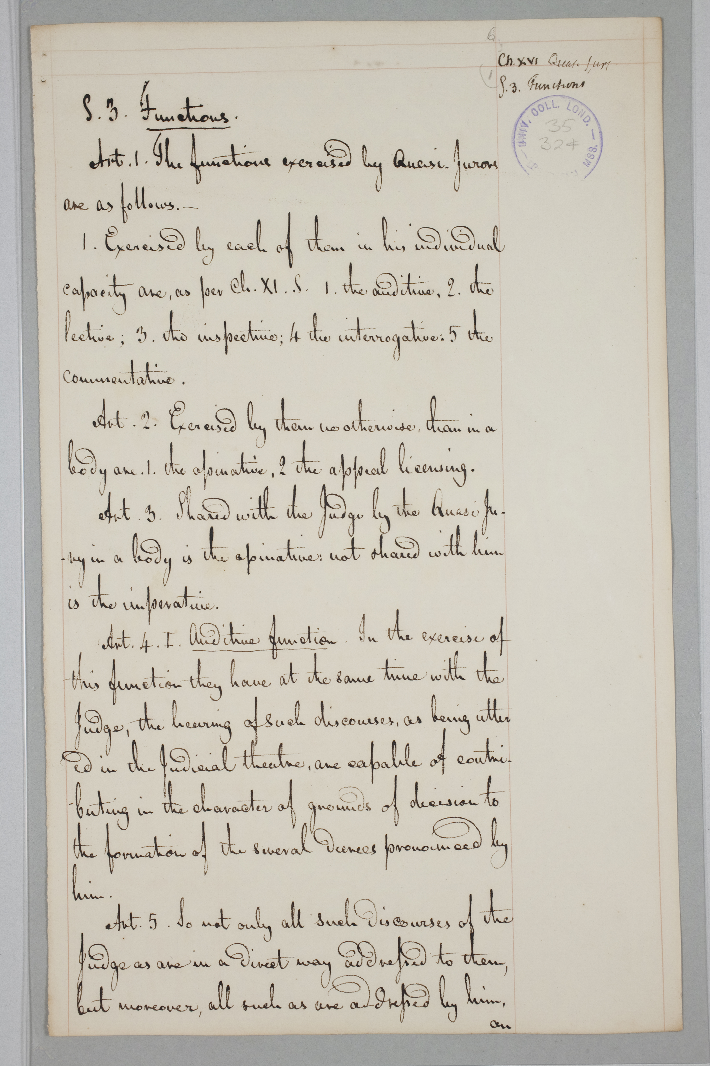
S. 3. Functions.
Art. 1. The functions exercised by Quasi-Jurors
are as follows. _
1. Exercised by each of them in his individual
capacity are. as per Ch. XI. S. 1. the auditive. 2. the
lective. 3. the inspective. 4 the interrogative. 5. the
commentative.
Art. 2. Exercised by them no otherwise. than in a
body are. 1. the apinative. 2 the appeal licensing.
Art. 3. Shared with the Judge by the Quasi Ju-
ry in a body is the apinative. not shared with him
is the imperative.
Art. 4. I. Auditive function. In the exercise of
this function they have at the same time with the
Judge. the hearing of such discourses. as being utter
ed in the Judicial theatre. are capable of contri-
-buting in the character of grounds of decision to
the formation of the several decrees pronounced by
him.
Art. 5. So not only all such discourses of the
Judge as are in a direct way addressed to them.
but moreover. all such as are addressed by him.
on

Slide 9
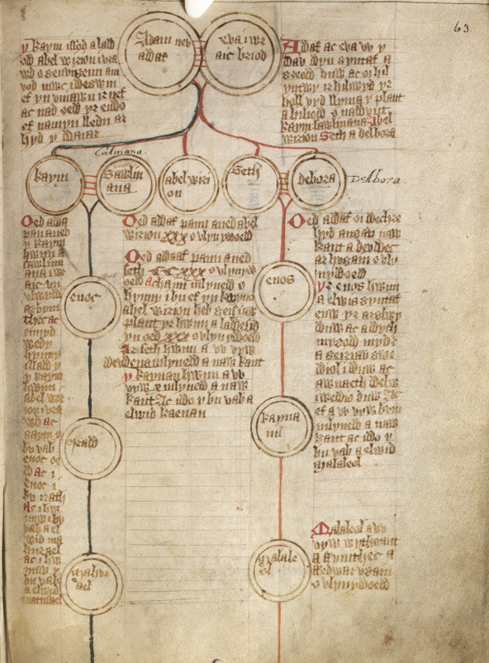

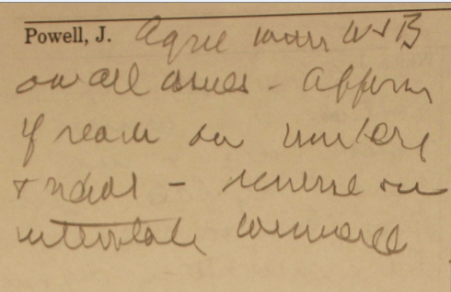
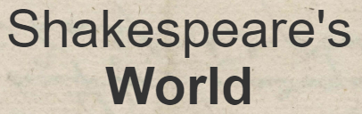
Why do we need transcription?
There are millions of digitized documents
Many libraries
Businesses e.g. Google books
Documents are not inherently searchable
Documents have cultural and historical value
By Gutun Owain - National Library of Wales, CC0, https://commons.wikimedia.org/w/index.php?curid=44768583
Notes:
So we know that we need them but this begs the question how do we get transcriptions?

Slide 10
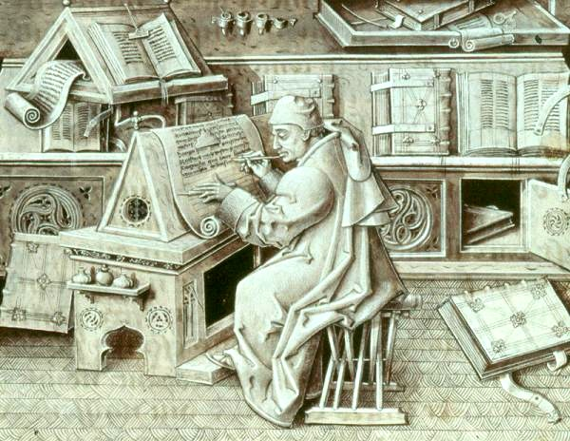
How do we get transcriptions?
Domain experts
E.g. historians, linguists
Bernard Bousmanne et Thierry Delcourt (dir.), Miniatures flamandes, Bibliothèque nationale de France/Bibliothèque royale de Belgique, 2012, 464
Notes:
There’s a limited number of domain experts

Slide 11
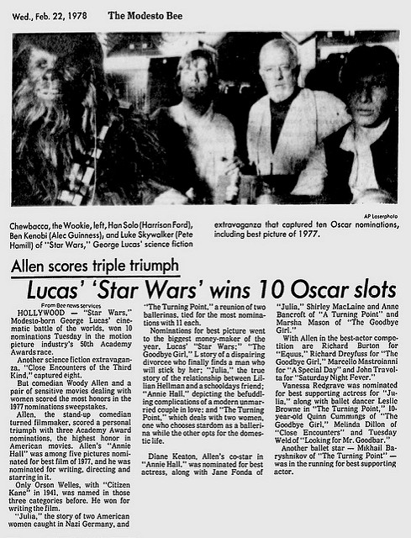
How do we get transcriptions?
Domain experts
E.g. historians, linguists
Optical Character Recognition (OCR)
https://www.flickr.com/photos/mmathab/5455177550/
Notes:
Optical character recognition looks at individual characters
Works great on printed text such as newspaper, not for handwritten text
If these don’t work, what can we do?

Slide 12
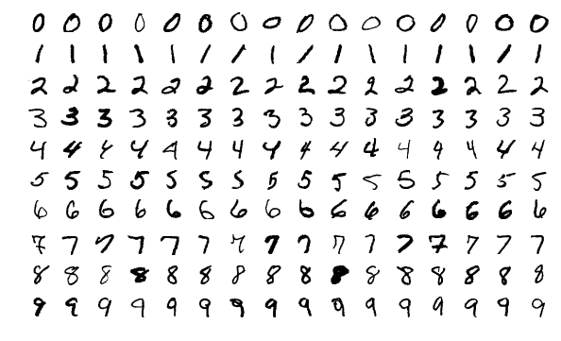
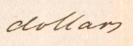
Why Doesn't OCR work?
Can't we do individual letters well?
E.g. MNIST
Well what about cursive?
https://commons.wikimedia.org/wiki/File:MnistExamples.png
Notes:
Optical character recognition looks at individual characters
Works great on printed text such as newspaper, not for handwritten text
If these don’t work, what can we do?

Slide 13
Transcription approaches

Slide 14
Crowdsourcing
“The practice of obtaining information or input into a task or project by enlisting the services of a large number of people, either paid or unpaid, typically via the Internet.” - Oxford English Dictionary
For example:
Zooniverse
Amazon Mechanical Turk
Transcribe Bentham (UCL)
Notes:
Zooniverse has many projects which shows how much interest there is in the subject

Slide 15
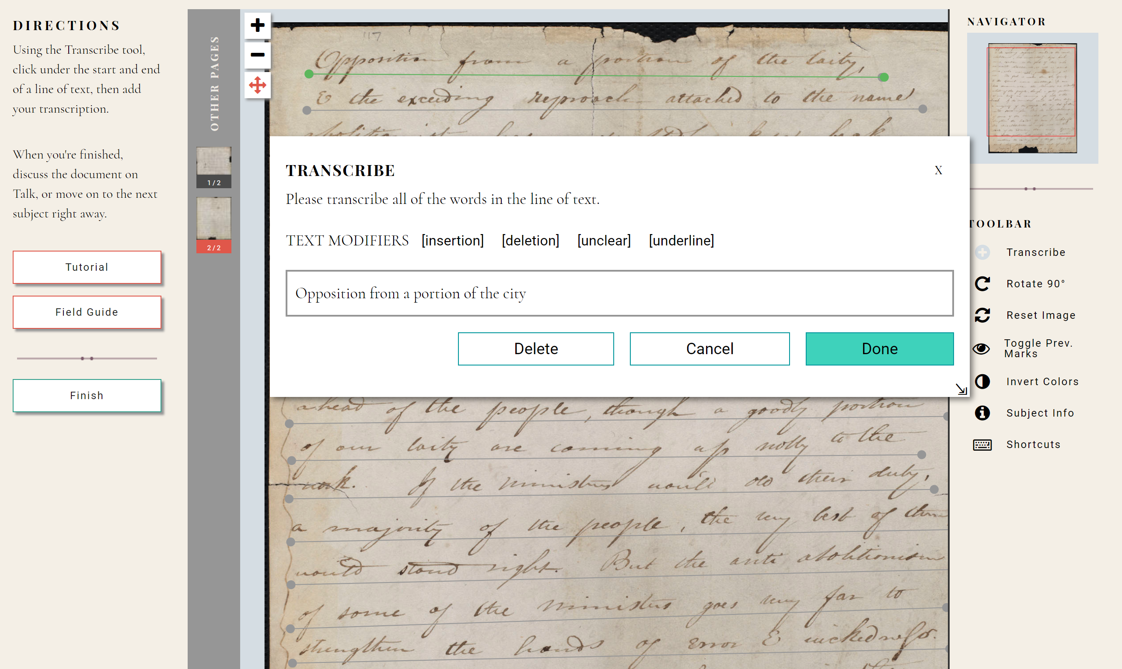
An example of a transcription project – Anti-Slavery Manuscripts (Zooniverse)
Notes:
Volunteers underline a line of text then label it with the transcriptions
This works very well but there are a limited number of people, and computers keep getting better at automated tasks

Slide 16
Machine transcription
Handwritten Text Recognition (HTR)
Methods are taken from automatic speech recognition
Active field – a long way until full automation is possible
Notes:
HTR has the same goal as optical character recognition but trying to do it on handwritten text
Speech is similar to handwriting – the goal is text, the input is structured
How is machine transcription done?

Slide 17
Project Goal: Combine humans and machines to make transcription more efficient and accurate than either can be on their own.

Slide 18
Handwriting recognition model

Slide 19
Text Segmentation
Split images (pages) into individual lines of text
Projection profile method
Notes:
OCR requires individual characters – this is too difficult. Sayre’s paradox

Slide 20
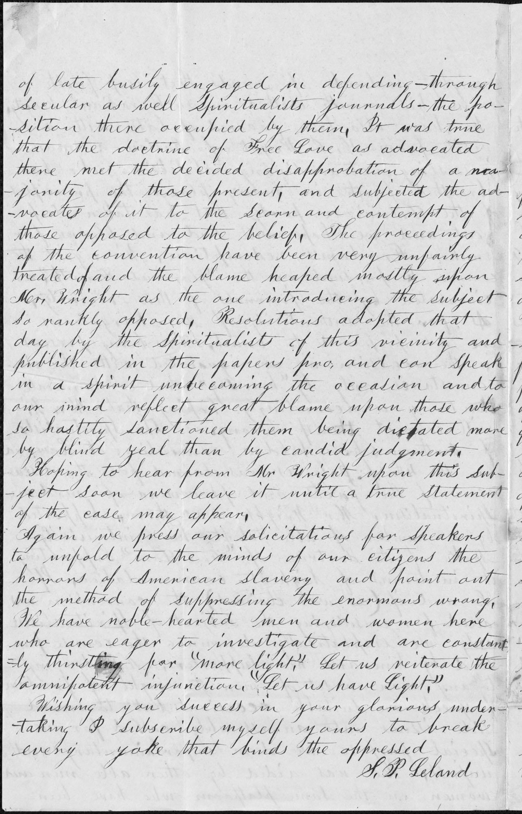
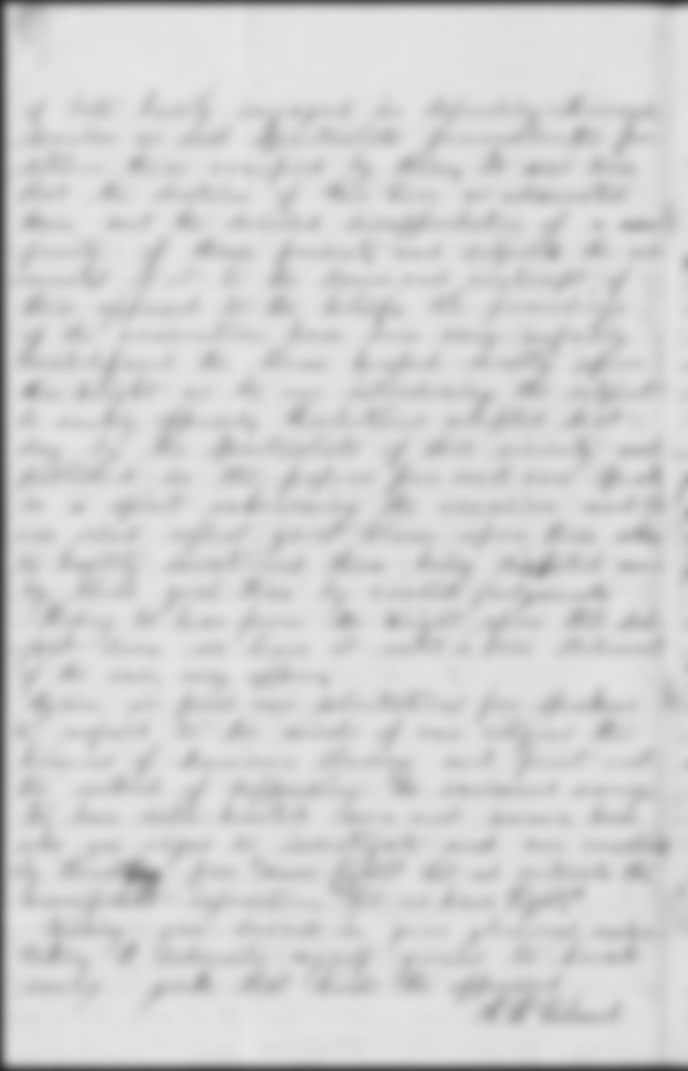
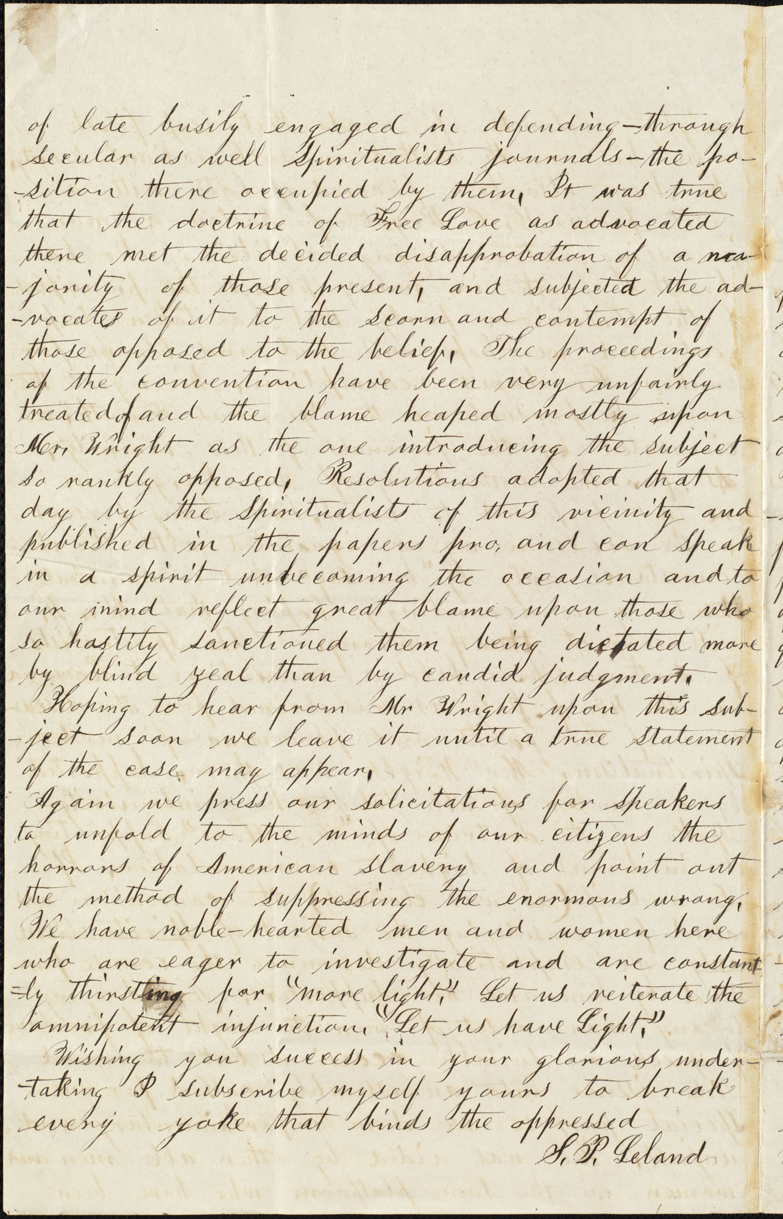
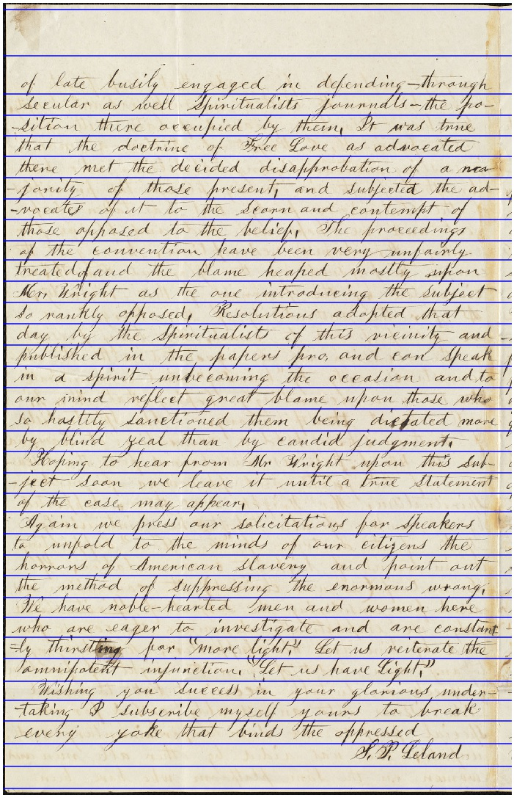
Notes:
Greyscale
Blur image with gaussian filter to remove noise
The peaks (on the left b/c image is rotated) represent many white pixels
The lines are the input to the machine model

Slide 21
Neural Network Architecture
Convolutional and recurrent layers
Specialized loss function – Connectionist Temporal Connectivity (CTC) loss
Notes:
CTC doesn’t re quire a segmented input, it’s able to map from a large input to something like text

Slide 22
Input image
Convolution 3x3
ReLU activation
Pooling 2x2
Convolution 3x3
ReLU activation
Pooling 2x2
Convolution 3x3
Batch normalization
ReLU activation
Convolution 3x3
ReLU activation
Pooling 2x1
Convolutional layers
Convolution 3x3
Batch normalization
ReLU activation
Convolution 3x3
ReLU activation
Pooling 2x1
Convolution 3x3
Batch normalization
ReLU activation
Notes:
Pooling – reduce size of data, helps avoid overfitting
Batch normalization – reduce variance of data
Bidirectional LSTM – allow for context

Slide 23
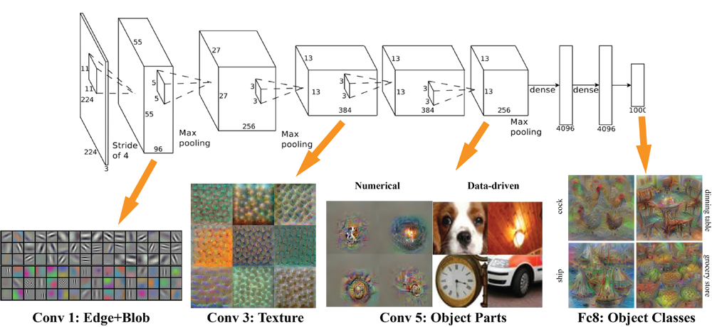
Convolutional Neural Networks
Mathematically: multiply sections of an image by a matrix (with learned weights)
Non-mathematically: a way to change the representation of image to something better understood by a machine
https://www.kisspng.com/png-deep-learning-convolutional-neural-network-alexnet-3064759/
Notes:
CTC doesn’t re quire a segmented input, it’s able to map from a large input to something like text

Slide 24
Input image
Convolution 3x3
ReLU activation
Pooling 2x2
Convolution 3x3
ReLU activation
Pooling 2x2
Convolution 3x3
Batch normalization
ReLU activation
Convolution 3x3
ReLU activation
Pooling 2x1
Convolutional layers
Convolution 3x3
Batch normalization
ReLU activation
Convolution 3x3
ReLU activation
Pooling 2x1
Convolution 3x3
Batch normalization
ReLU activation
Bidirectional LSTM along horizontal axis
256 hidden units
Bidirectional LSTM along horizontal axis
256 hidden units
Dropout layer
Keep prob = 0.7
Recurrent layers
Notes:
Pooling – reduce size of data, helps avoid overfitting
Batch normalization – reduce variance of data
Bidirectional LSTM – allow for context

Slide 25
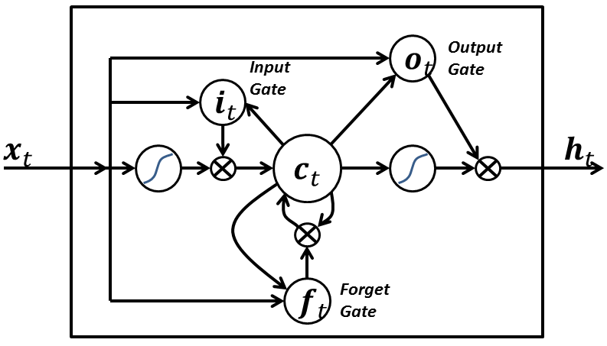
Long Short-Term Memory Units
A type of recurrent neural network
Solves gradient descent issues with standard RNN
Allows for use of context
We can make them bidirectional
https://commons.wikimedia.org/wiki/File:Long_Short_Term_Memory.png
https://github.com/PetarV-/TikZ/tree/master/Bidirectional%20long%20short-term%20memory
Notes:
CTC doesn’t re quire a segmented input, it’s able to map from a large input to something like text

Slide 26
Input image
Convolution 3x3
ReLU activation
Pooling 2x2
Convolution 3x3
ReLU activation
Pooling 2x2
Convolution 3x3
Batch normalization
ReLU activation
Convolution 3x3
ReLU activation
Pooling 2x1
Convolutional layers
Convolution 3x3
Batch normalization
ReLU activation
Convolution 3x3
ReLU activation
Pooling 2x1
Convolution 3x3
Batch normalization
ReLU activation
Bidirectional LSTM along horizontal axis
256 hidden units
Bidirectional LSTM along horizontal axis
256 hidden units
Dropout layer
Keep prob = 0.7
Recurrent layers
Fully connected layer
CTC Loss and Beam Search Decoder
Transcription layers
Notes:
Pooling – reduce size of data, helps avoid overfitting
Batch normalization – reduce variance of data
Bidirectional LSTM – allow for context

Slide 27
Connectionist Temporal Classification Loss
Ɛ | d | d | Ɛ | o | o | l | Ɛ | l | a | a | Ɛ | r | s | Ɛ | Ɛ
The way we deal with the lack of segmentation
Ɛ | d | Ɛ | o | l | Ɛ | l | a | Ɛ | r | s | Ɛ
 | d |  | o | l |  | l | a |  | r | s
d | o | l | l | a | r | s
Notes:
CTC doesn’t re quire a segmented input, it’s able to map from a large input to something like text

Slide 28
Input image
Convolution 3x3
ReLU activation
Pooling 2x2
Convolution 3x3
ReLU activation
Pooling 2x2
Convolution 3x3
Batch normalization
ReLU activation
Convolution 3x3
ReLU activation
Pooling 2x1
Convolutional layers
Convolution 3x3
Batch normalization
ReLU activation
Convolution 3x3
ReLU activation
Pooling 2x1
Convolution 3x3
Batch normalization
ReLU activation
Bidirectional LSTM along horizontal axis
256 hidden units
Bidirectional LSTM along horizontal axis
256 hidden units
Dropout layer
Keep prob = 0.7
Recurrent layers
Fully connected layer
CTC Loss and Beam Search Decoder
Transcription layers
Notes; and private Promissory Notes and Bills of Exchange.
Final Transcription
Notes:
Pooling – reduce size of data, helps avoid overfitting
Batch normalization – reduce variance of data
Bidirectional LSTM – allow for context

Slide 29


Model training
Implemented in Tensorflow
Run on google cloud GPU
Three datasets:
IAM Handwriting Database
Bentham Collection
Anti-Slavery Manuscripts
Model pre-training on IAM and Bentham data
Transfer learning
Image size determined experimentally
Notes:
IAM: modern (no degradation), >600 authors, > 10,000 lines of text
Bentham: historical (late 1700s), a few authors, > 10,000 lines of text
Models don’t generalize well but they can take advantage of training from other data. E.g. English → Chinese
I’ll talk about image size in results

Slide 30
Online training – on Anti-Slavery Manuscripts
Get batch of 1000 transcriptions
Predict transcriptions for batch
Train model on current batch
Train model on random batch of previously seen data
Repeat until all transcriptions seen
Notes:
“Online” != on the web
Simulate online training using the order classifications came in
Consensus is not taken because neural networks can handle noise

Slide 31
Results

Slide 32
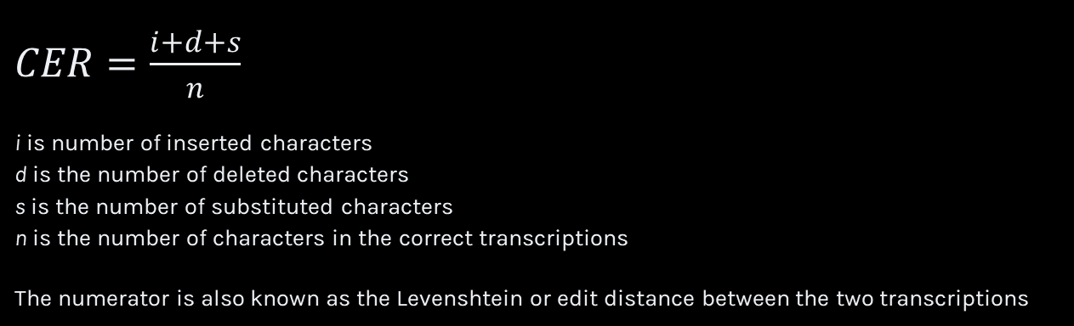
Character Error Rate (CER)
$CER=\frac{i+d+s}{n}$
i is number of inserted characters d is the number of deleted characters s is the number of substituted characters n is the number of characters in the correct transcriptions
The numerator is also known as the Levenshtein or edit distance between the two transcriptions
Notes:
Mention what training vs. validation is as well

Slide 33
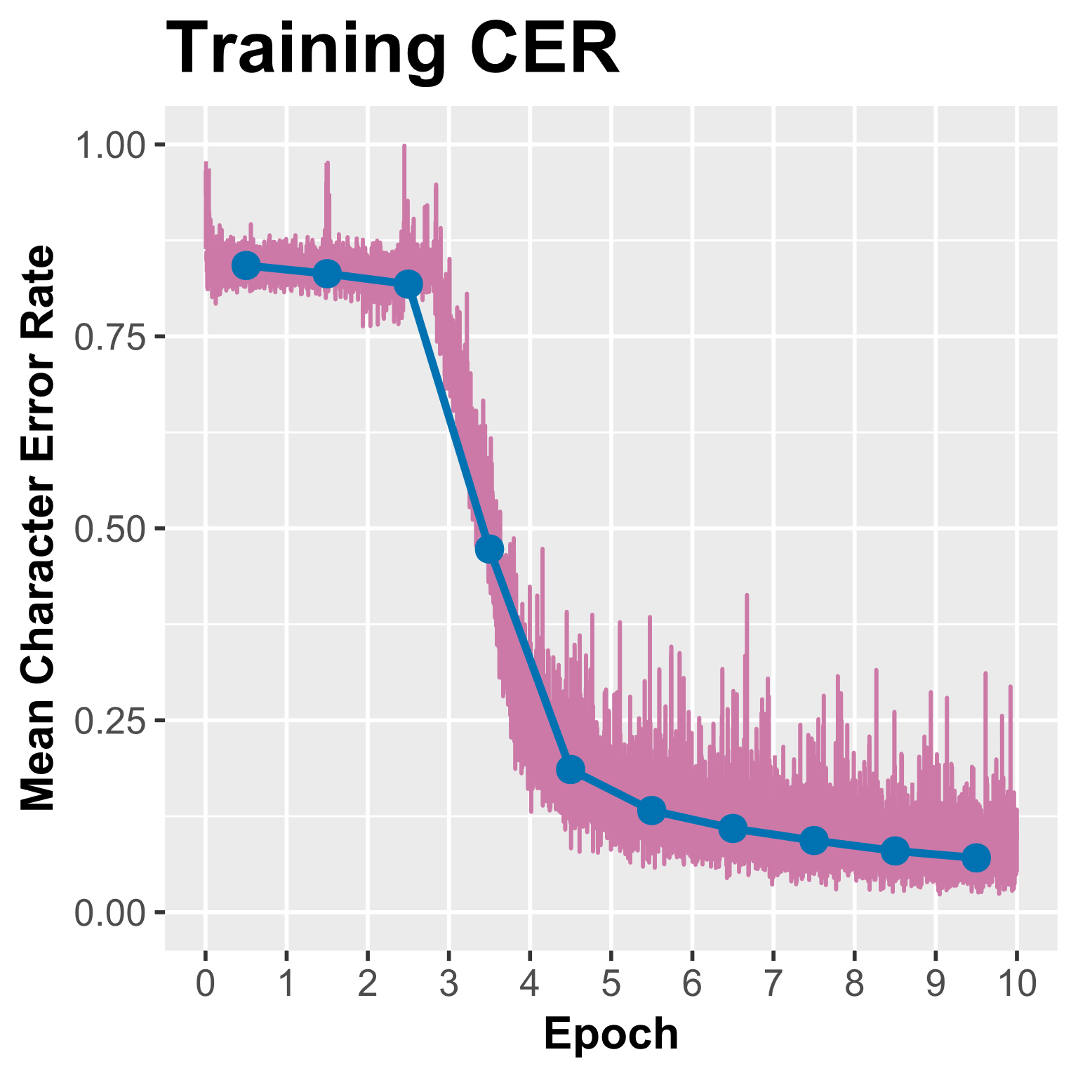
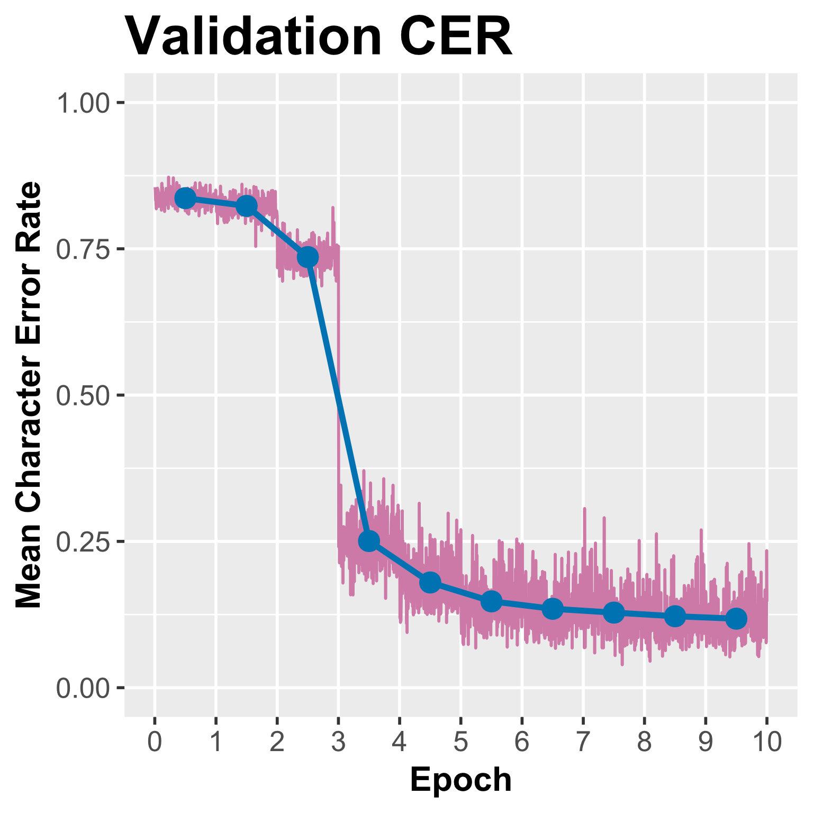
Pre-training
Notes:
Important because it show models are able to generalize within the data that they’re given – with enough data, this should work well on anything. Also show performance on a curated set

Slide 34
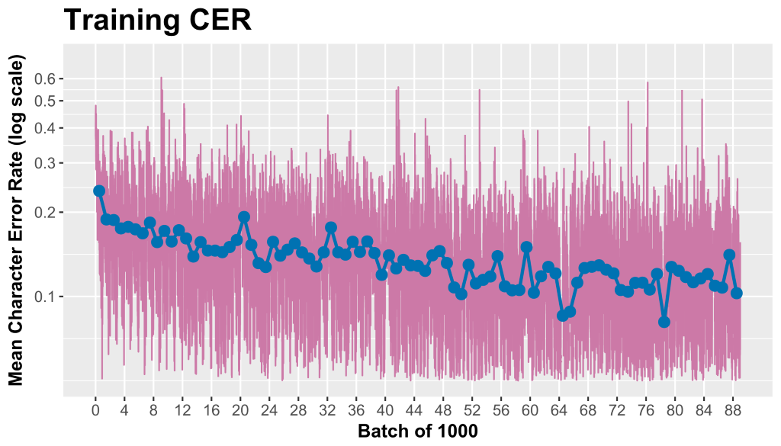
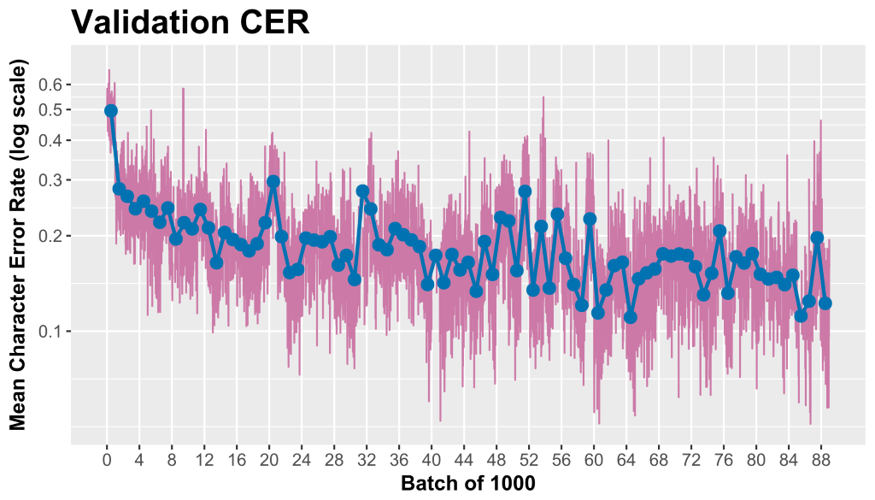
Online experiment
Prediction is noisy
Steady improvement
Notes:
At the time of initially running this, I stopped at 60,000, I am now rerunning this to get further results

Slide 35
Volunteer transcription:
was brought before one of the persons who
Machine transcription:
was brought before one of the pessons who
CER: 0.02
Volunteer transcription:
a christian brother on the subject I will say that
Machine transcription:
a christian btoshet on the subjrrt I will sey tha
CER: 0.14
Examples of machine transcriptions
Notes:
These are predictions i.e. the model has never seen these lines of text before

Slide 36
Volunteer transcription:
is here. - There was a Lady of one congregation whose husband
Machine transcription:
is dac. - Here was a ady of or congrugation whase Mustad
CER: 0.23
Volunteer transcription:
who had known Mary Smith were procured
Machine transcription:
wntrs had krroun Mary Mrithe wereprocuce
CER: 0.34
Examples of machine transcriptions

Slide 37
Next Steps

Slide 38
Zooniverse Incorporation
Segment images into text lines
Verify segmentation with Zooniverse project
Online learning with machine and volunteer feedback loop
Pre-train model or use existing model

Slide 39
Online Training
Get batch of 1000 transcriptions
Predict transcriptions for batch
Train model on current batch
Train model on random batch of previously seen data
Repeat until all transcriptions seen
Notes:
This is what the current online training looks like

Slide 40
Online Training with Feedback Loop
Get batch of images
Predict transcriptions for batch
Show prediction to volunteers
Train model on new volunteer classifications
Train model on random batch of previously seen data
Repeat until all lines of text seen
Notes:
We wouldn’t change a lot

Slide 41
Why the feedback loop?
Computers aren’t perfect
Humans are really good at certain types of pattern recognition
There are a lot of people!

Slide 42
More Reading
CTC Loss
https://distill.pub/2017/ctc/
CNNs
https://developers.google.com/machine-learning/practica/image-classification/convolutional-neural-networks
LSTMs
https://colah.github.io/posts/2015-08-Understanding-LSTMs/
Are RNNs going away?
https://towardsdatascience.com/the-fall-of-rnn-lstm-2d1594c74ce0

Slide 43
References
[1] U.-V. Marti and H. Bunke, “The IAM-database: an English sentence database for offline handwriting recognition,” IJDAR, vol. 5, no. 1, pp. 39–46, Nov. 2002.
[2] B. Gatos et al., “Ground-Truth Production in the Transcriptorium Project,” in 2014 11th IAPR International Workshop on Document Analysis Systems, 2014, pp. 237–241.
[3] J. A. Sánchez, V. Romero, A. H. Toselli, and E. Vidal, “ICFHR2014 Competition on Handwritten Text Recognition on Transcriptorium Datasets (HTRtS),” in 2014 14th International Conference on Frontiers in Handwriting Recognition, 2014, pp. 785–790.

Slide 44
Acknowledgments
I would like to thank my advisor Lucy Fortson as well as Darryl Wright, Hugh Dickinson, Michael Laraia, Andrea Simenstad, Marco Willi, and Samantha Blickhan for their specific feedback on various elements of this project. I would also like to thank the Zooniverse team as a whole for their resources and support throughout this project.
The University of Minnesota Zooniverse Team is partially supported by NSF IIS 1619177. Financial support for portions of this research come from the University of Minnesota’s Digital Arts Sciences and Humanities Program

Slide 45
Thank you!

Slide 46
Questions?

Slide 47
Interactive session

Slide 48
Interactive session
Code for interactive session:
https://github.com/danhan52/teaching_and_learning/handwriting_recognition_meetup
All text recognition work:
https://github.com/danhan52/text_recognition

